Slide 1
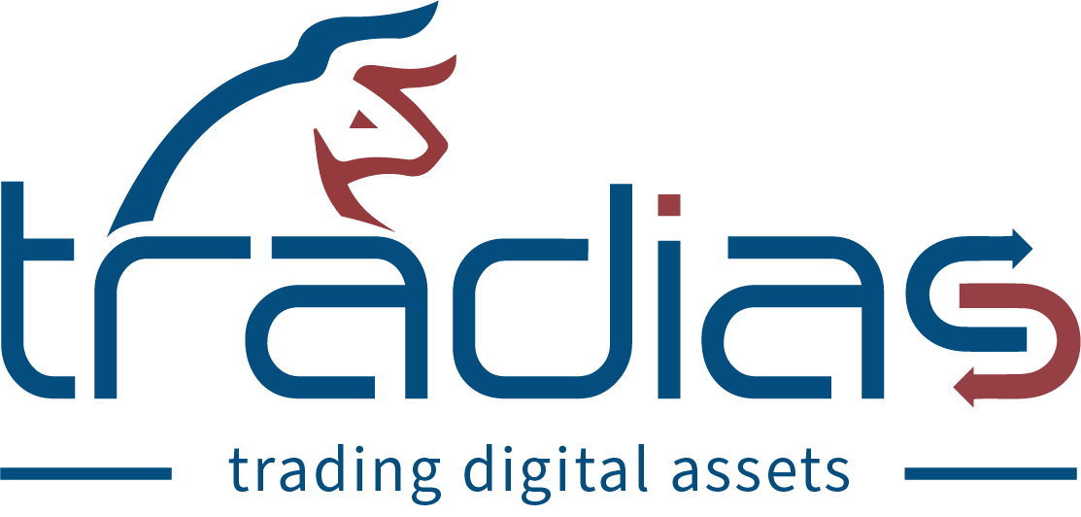
tradias is a fast-growing start-up with offices in Frankfurt, Athens and Toronto. Based on the in-depth expertise of our banking partner, Bankhaus Scheich - one of Germany's leading securities trading banks and a major market maker on the Frankfurt Stock Exchange - we offer our institutional clients a secure platform for trading digital assets. In addition to trading, we offer a wide range of services for digital assets.
Head of Software Engineering (m/f/d)
Frankfurt am Main, Germany
We are looking for an experienced engineer with a strong product mindset and a passion for helping others succeed. The ideal candidate will have experience managing agile development teams and a proven track record of delivering high-quality software products on time and within budget . You are looking for a dynamic environment in which you can use your strengths and develop yourself further? Our agile FinTech is the place to be for you! Grow with us and let's innovate the European crypto and digital assets universe together.
Your Tasks:
Build, lead and manage a high-performing development team, ensuring efficient and effective delivery of software projects
Oversee the entire software development lifecycle, from concept to deployment, ensuring adherence to best practices and agile methodologies
Collaborate closely with cross-functional teams, including product management, design, and operations, to define project scope, goals, and deliverables
Foster a culture of continuous improvement, encouraging innovation and the adoption of new technologies and practices, ensuring the team remains competitive and at the forefront of industry trends
Develop and manage the development budget, ensuring that resources are used effectively and efficiently
Implement and enforce best practices for coding, testing, and deployment to ensure the highest quality of deliverables
Make decisions regarding the technology stack, tools, and frameworks to ensure scalability, reliability, and efficiency
Oversee architectural decisions and ensure the development of scalable and maintainable systems
Identify and mitigate relevant risks associated with software development, ensuring a smooth and predictable development process
Your Profile:
Bachelor’s degree in Computer Science, Engineering, or a related field. Master’s degree is a plus
Minimum of 5 years of experience managing agile development teams, with a strong understanding of agile methodologies (e.g., Scrum, Kanban).
Proven experience in leading the development of complex software products, with a strong focus on quality, scalability, and performance.
Excellent leadership and team management skills, with a track record of building and motivating high-performing teams.
Strong technical background with hands-on experience in software development, architecture, and design.
Exceptional communication and interpersonal skills, with the ability to collaborate effectively with both technical and non-technical stakeholders.
Experience with cloud-based development environments and DevOps practices is highly desirable.
Strong problem-solving skills and the ability to make decisions under pressure.
A passion for innovation and a commitment to staying current with industry trends.
tradias offers:
Work with experts from the digital assets / crypto industry
Flat hierarchies
Flexible working hours with home office options
International and modern working environment
Strongly motivated young and dynamic team
A high degree of self-reliance, responsibility, and development perspective
30 days vacation/year
Attractive compensation package
Team and company events
A modern office right in heart of the financial center Frankfurt
Be part of our driven team! Send us your complete application via e-mail to the address karriere@tradias.de, stating the earliest possible joining date and your salary expectations.
Formulations referring to individuals in the job advertisement are to be considered gender-neutral.
tradias is an Equal Opportunity / Affirmative​ Action employer. All qualified applicants will receive consideration for employment without regard to race, color, religion, sex, national origin, sexual orientation, gender identity, disability, or any other characteristic protected by state, federal, or local law.

